Slide 1

Python Day 5 – Loops
Mastering For Loops, While Loops, and Control Statements
Mahaktech – Basic to Advanced Python Training

Slide 2
What Are Loops?
Understanding Loops
Real-Life Examples
A loop is a programming construct that repeats a block of code automatically until a specific condition is met. Instead of writing the same code multiple times, loops help us execute instructions efficiently.
Alarm clock – Rings repeatedly until you turn it off
Ceiling fan – Blades rotate continuously while switched on
Attendance check – Teacher calls each student's name one by one
Loops are essential for automation, data processing, and handling repetitive tasks in programming.
Traffic signal – Changes colours in a repeating sequence

Slide 3
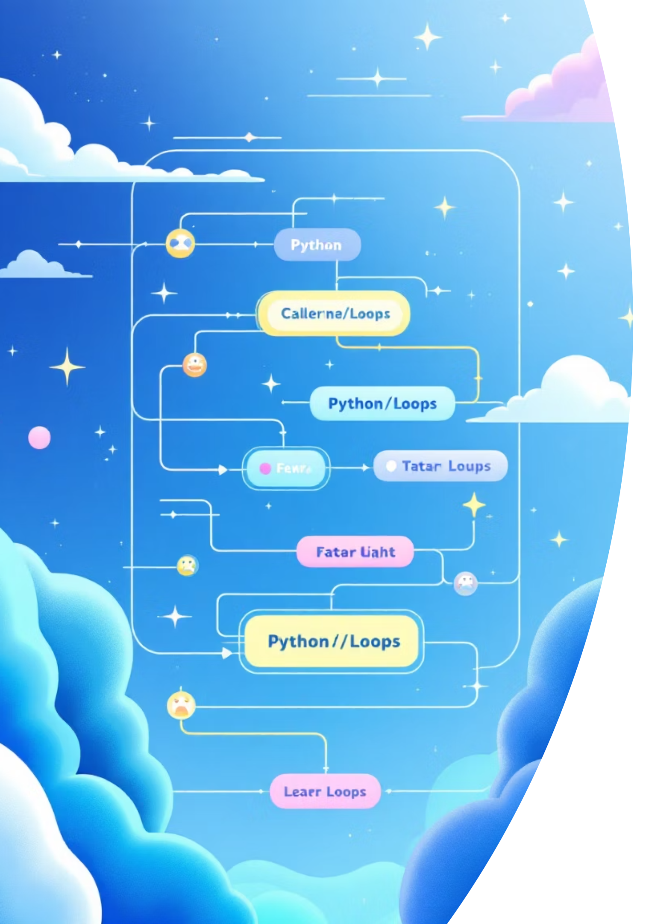



Types of Loops in Python
For Loop
Used when you know exactly how many times the code should repeat. Perfect for iterating through sequences like lists, ranges, or strings.
Best for: Known repetitions
While Loop
Used when repetition depends on a condition being true. The loop continues until the condition becomes false.
Best for: Conditional repetitions

Slide 4
For Loop – Introduction
What Is a For Loop?
Understanding range()
A for loop iterates over a sequence of elements, executing the code block for each element. It's perfect when you know in advance how many iterations are needed.
range(n) – Generates numbers from 0 to n-1
for i in range(5): print(i)# Output: 0, 1, 2, 3, 4
Basic Syntax
The variable i takes each value in the sequence, and the indented code runs for each value.
for variable in sequence: # code block print(variable)
The range() function generates a sequence of numbers, making it ideal for controlling loop iterations.

Slide 5
The range() Function Explained
01
02
03
range(n)
range(start, end)
range(start, end, step)
Generates numbers from 0 to n-1
Generates numbers from start to end-1
Generates numbers with a custom step value
range(5)# Output: 0, 1, 2, 3, 4
range(2, 8)# Output: 2, 3, 4, 5, 6, 7
range(0, 10, 2)# Output: 0, 2, 4, 6, 8
You can also use negative steps to count backwards!

Slide 6


For Loop – Practical Examples
1
2
3
Print Numbers 1 to 5
Repeat a Message
Print Even Numbers
for i in range(1, 6): print(i)
for i in range(3): print("Welcome to Python!")
for i in range(2, 11, 2): print(i)
Output: 1, 2, 3, 4, 5
Prints the message three times
Output: 2, 4, 6, 8, 10

Slide 7

While Loop – Introduction
What Is a While Loop?
Simple Example
A while loop repeats code as long as a condition remains true. It's ideal when you don't know in advance how many times the loop should run.
count = 1while count <= 5: print(count) count = count + 1
Basic Syntax
while condition: # code block print("Running...")
Output: 1, 2, 3, 4, 5
Important: Always update the variable inside the loop, or it will run forever!
The loop checks the condition before each iteration. If true, it executes the code block; if false, it stops.

Slide 8
While Loop – Real-World Examples
Password Verification
Sensor Data Reading
In IoT applications, while loops continuously read sensor data until a stop condition is met, such as temperature exceeding a threshold or user interruption.
password = ""while password != "python123": password = input("Enter password: ")print("Access granted!")
Keeps asking until the correct password is entered

Slide 9
Warning: Infinite Loops!
What Is an Infinite Loop?
Correct Code ✅
An infinite loop runs forever because the exit condition never becomes false. This can freeze your programme or consume excessive resources.
count = 1while count <= 5: print(count) count = count + 1
Wrong Code ❌
count = 1while count <= 5: print(count) # Forgot to update count!
Always ensure your loop variable is updated inside the loop to eventually make the condition false.
Tip: Use Ctrl+C to stop an infinite loop in the terminal
This prints "1" forever because count never increases.

Slide 10
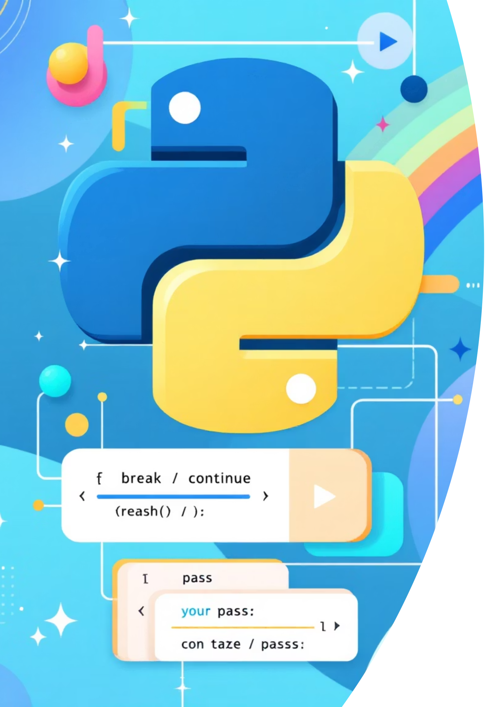



Loop Control Statements
break
Immediately stops the loop and exits
for i in range(10): if i == 5: break print(i)
Output: 0, 1, 2, 3, 4
continue
Skips the current iteration and moves to the next
for i in range(5): if i == 2: continue print(i)
Output: 0, 1, 3, 4 (skips 2)
pass
Does nothing, acts as a placeholder
for i in range(3): pass # Code to be added later
Useful when syntax requires code but you don't want to execute anything yet

